Slide 1
Financial Goals
Katherine Montano

Slide 2
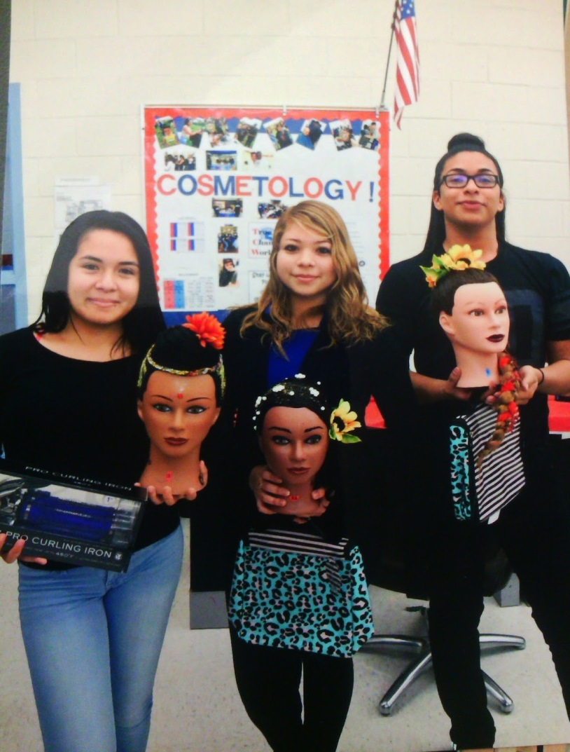
Long-Term Career Goal
I would like to be a cosmetologist. I want this career because it’s really fun and also I like to make people feel good about themselves. If I do this career I will be making $10.82 per hour, with an average annual income of $22,500 to 40,000.

Slide 3
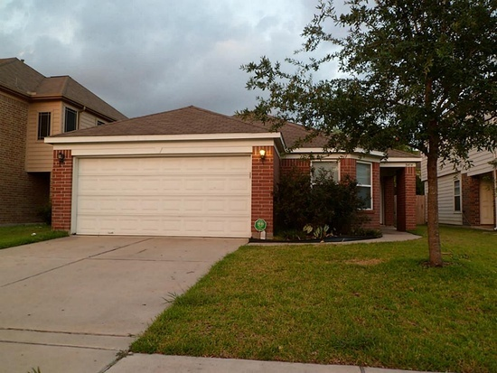
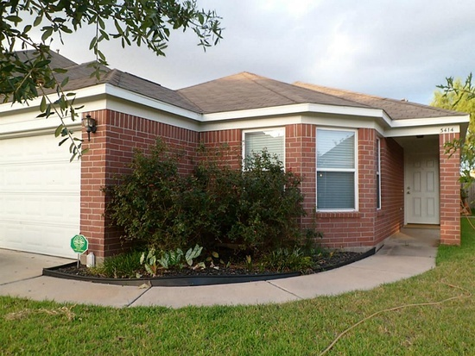
Long-Term House goals
I would rather to buy a house because in this way I will know that one day will be mine. I would live on Texas because is cheaper. The address for the house that I would like to buy is 3414 Clipper Winds Way Houston, TX 77084 this house has 3 beds 2 baths 1,769 sqft, it cost $50,000 and the mortgage is $189 per month.

Slide 4
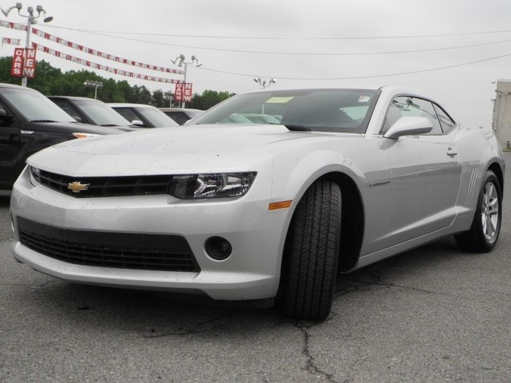
Long-Term Goal #3
Another thing that is really important to me is to have my own car. This is important because that how I will ride from my home to work and also anywhere I would want to go. This would cost $22,94.

Slide 5
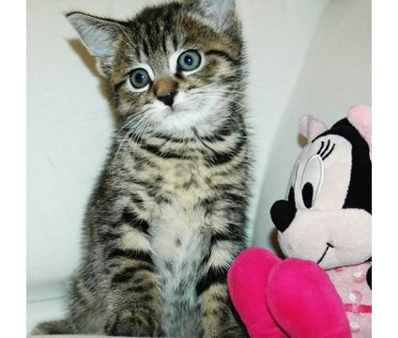
Long-Term Goal #4
Another thing that is important to me is to have a cat because they are cute and they bring happiness to my life. This would cost $400.

Slide 6
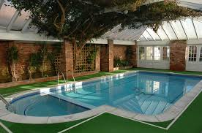
Long-Term Goal #5
Another thing that is important to me is to create a pool in my house because its fun to entertain yourself in a place that you know that there would not be any trouble to do celebrate or make fun all your days. All the materials that I would spend on it would cost around 5,000 dollars.

Slide 7
Summary of Long Term Goals
I’m planning to earn around 100,000 dollars. I think this will take like 15 years. Right now I’m planning to spend as less as I can. Therefore my goals will came

Slide 8
How do I accomplish my Long-Term goals?
First I want to move to Texas and make some changes if I don’t like something about it. Secondly, I want to save money to buy a car in this way I would take a course for the career that I want to be and to get my license. After this I want to find a job of cutting hair and doing make up near my home. Thirdly, I want to have a cat, so I would not feel alone. Finally, I want to create a pool near the playground to have fun and be happy.

