Slide 1
Product Research
By Katherine Montano

Slide 2
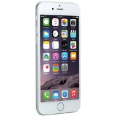
IPhone 6
Price Range: 399 - 699.84
Product Specs
Demand factors:
  It has good applications
  Print finger to unlocked
Supply factors:
  Cheap labor from USA
  Easy to transport
Elasticity:
  This is an elastic product: if the price increases, people will buy other brands.

Slide 3
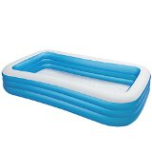
Intex swim center
Price Range: 19.99 - 34.90
Product Specs
Demand factors:
  Kids want swim pool’s in their homes
  Its fun
Supply factors:
  Cheap labor from Italy
  Cheap materials
Elasticity:
  This is an elastic product: if the price increases, people will buy other brands.

Slide 4

Pink laptop
Price Range: 149.99 163.99
Product Specs
Demand factors:
  The color is nice
  Easy to carry
Supply factors:
  Cheap labor from China
  Iron
Inelasticity:
  This is an inelastic product: if the price increases, people will still buying this prod.

Slide 5
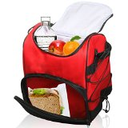
Lunch bag
Price Range: 19.61 - 35
Product Specs
Demand factors:
  Its useful
  It has a lot of space
Supply factors:
  Cheap labor from USA
  Polyester materials
Inelasticity:
  This is an inelastic product: if the price increases, people will still buying this product because is needed.

Slide 6
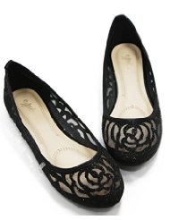
Walstar women
Price Range: 13.59 - 29.65
Product Specs
Demand factors:
  They are comfortable
  The design is pretty
Supply factors:
  Cheap labor from USA
  Different colors
Elasticity:
  This is an elastic product: if the price increases, people will buy other brands.

Slide 7
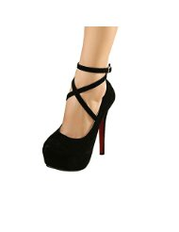
Women ankle strap platform
Price Range: 14.99 - 23.99
Product Specs
Demand factors:
  Looking of a professional women
  Good for short girls
Supply factors:
  Cheap labor from China
  Professional material
Elasticity:
  This is an elastic product: if the price increases, people will buy other brands.

Slide 8
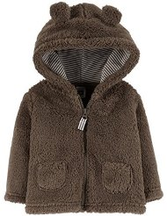
Carter’s baby boy’s
Price Range: 10.99 - 35
Product Specs
Demand factors:
  Its soften
  The design
Supply factors:
  Cheap labor from USA
  Great quality
Elasticity:
  This is an elastic product: if the price increases, people will buy other brands.

Slide 9
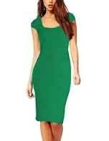
senfloco lady dress
Price Range: 25.94 – 26.96
Product Specs
Demand factors:
  Good for church
  Color its great
Supply factors:
  Cheap labor from Germany
  Good material
Elasticity:
  This is an elastic product: if the price increases, people will buy other brands.

Slide 10
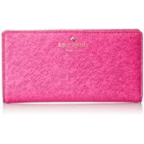
Kate spade Pink Purse
Price Range: 79.98 - 158
Product Specs
Demand factors:
  Save important staffs
  Its small
Supply factors:
  Cheap labor from China
Elasticity:
  This is an elastic product: if the price increases, people will buy other brands.

Slide 11
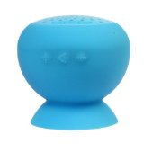
Waterproof Bluetooth speaker
Price Range: 5.63 – 11.69
Product Specs
Demand factors:
  Its colorful
  Its loud
Supply factors:
  Cheap labor from China
  Special material
Elasticity:
  This is an elastic product: if the price increases, people will buy other brands.

