Slide 1
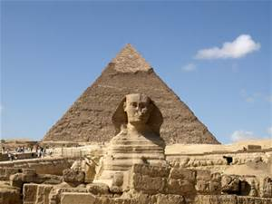
Profile of Egypt
Katherine Montano

Slide 2
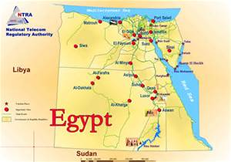
Egypt
Exports | %
Crude Petroleum | 18
Petroleum Gas | 10
Refined Petroleum | 8.6
Gold | 4.5
Nitrogenous Fertilizers | 3.4
This is a profile of Egypt. It is the second richest country in the region of North Africa and Middle East. The GDP of Egypt is approximately 369.267 billion per year.

Slide 3
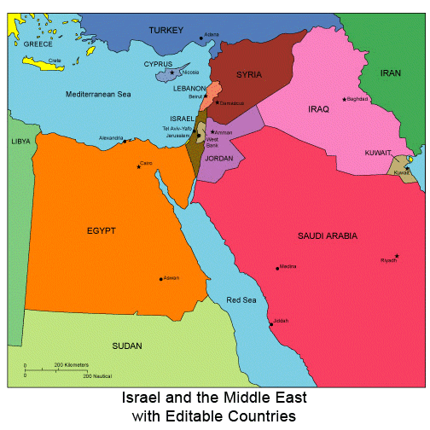
Regional Economies
Country | GDP | Main Exports
Saudi Arabia | 906.8 billion | Crude Petroleum, Refined Petroleum, Ethylene Polymers, Acyclic Alcohols and Petroleum Gas.
Egypt | 369.267 | Crude Petroleum, Petroleum Gas, Refined Petroleum, Gold and Nitrogenous Fertilizers
Sudan | 159.5 billion | Oil, Cotton, Groundnuts, Gum Arabic and Sugar.
Libya | 37.94 billion | Crude Oil, Refined Petroleum Products, Natural Gas and Chemicals.
The regional economy is strong. The region is dominated by Saudi Arabia. However, the other countries in the region are weaker. Libya is behind the other countries in exports and GDP.

