Slide 1
WISE Buyer versus Conspicuous Consumer
Katherine Montano

Slide 2
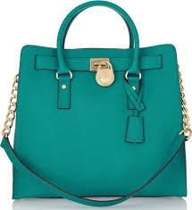
Conspicuous Buy: Michael Kors
Michael Kors Purse
Price: $554
Why is it conspicuous?
Its expensive and all ladies want this purse
Why is it expensive?
This purse is attractive to ladies and make them to get attention.

Slide 3
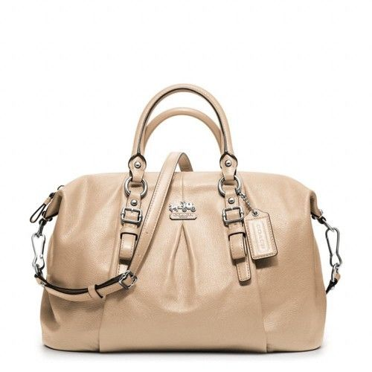
Wise Buy: coach
Coach purse
Price: $149
Why is it WISE?
This purse is cheaper and has similar this from the expensive purses.
I sacrifice the brand of the purse but I don’t care that much.

Slide 4
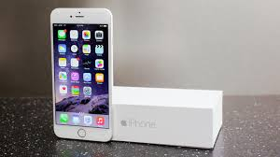
Conspicuous Buy: IPhone 6+
IPhone 6 plus 16 GB
Price: $1,098.99
Why is it conspicuous?
Its expensive and people buy it because they can connected with any company.
Why is it expensive?
This Phone Its expensive because it has a 5.5 inch screen and also is unlocked and the battery can hold up to 24 hours.

Slide 5
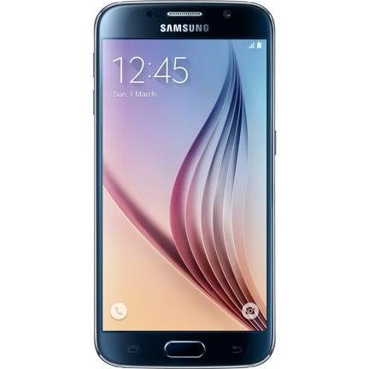
Wise Buy: Samsung Galaxy
Samsung Galaxy phone with 32 GB
Price: $500
Why is it WISE?
This purse is cheaper and has more GB
I sacrifice the inches because this phone is 5.1 inches but I really don’t care that much.

Slide 6
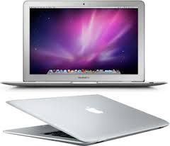
Conspicuous Buy: laptop
Apple MacBook Pro laptop with 160 GB
Price: $503.10
Why is it conspicuous?
Its expensive and has more technology
Why is it expensive?
This laptop has a lot of space so people would save things and it has 13 inches.

Slide 7
Wise Buy: laptop
Acer Chromebook laptop with 32 GB
Price: $129
Why is it WISE?
This laptop is cheaper and has similar qualities from the apple laptops.
I sacrifice the inches because this laptop just 11.6 inches.

Slide 8
Conspicuous Buy: shoes
Macy’s shoes
Price: $79.99
Why is it conspicuous?
Its expensive and all ladies want this shoes
Why is it expensive?
This shoes give professionalism to ladies and it’s made with good material.

Slide 9
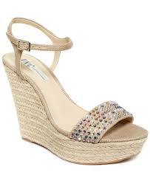
Wise Buy: shoes
Jcpenny shoes
Price: $39
Why is it WISE?
This shoes are cheaper and are similar to the others.
I sacrifice the brand of the shoes but I don’t care that much.

Slide 10
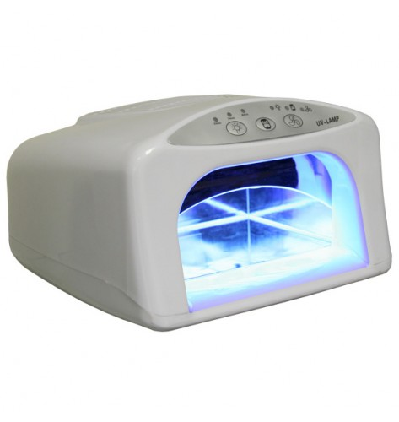
Conspicuous Buy: Nail dryer
UV single nail dryer
Price: $45
Why is it conspicuous?
Its expensive and people like their nails to be dry faster.
Why is it expensive?
This nail dry its expensive because its brand and it dry nail faster.

Slide 11
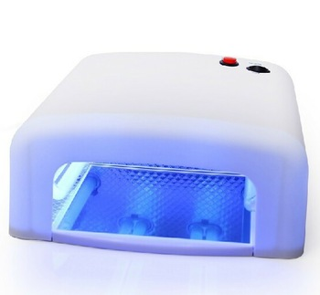
Wise Buy: nail dryer
36 W nail dryer
Price: $17.59
Why is it WISE?
This nail dryer is cheaper and has similar qualities from others that are brands.
I sacrifice the brand of the nail dryer and that it not dry faster.

Slide 12
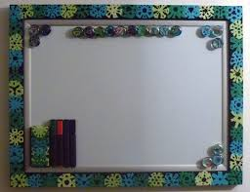
Conspicuous Buy: board
Universal dry board
Price: $25
Why is it conspicuous?
Its not that expensive and it has good design.
Why is it expensive?
This board its expensive because it has markers and it brings all the materials that you need.

Slide 13
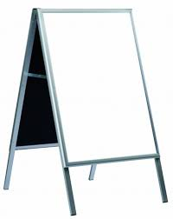
Wise Buy: board
Normal board
Price: $16.92
Why is it WISE?
This board is cheaper and has the same material to write on.
I sacrifice the markers and the design that the other have.

Slide 14
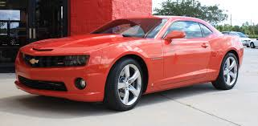
Conspicuous Buy: car
2015 Chevrolet Camaro
Price: $23,705
Why is it conspicuous?
Its expensive and its attractive
Why is it expensive?
This car its expensive because its made with good material and its not common between others.

Slide 15
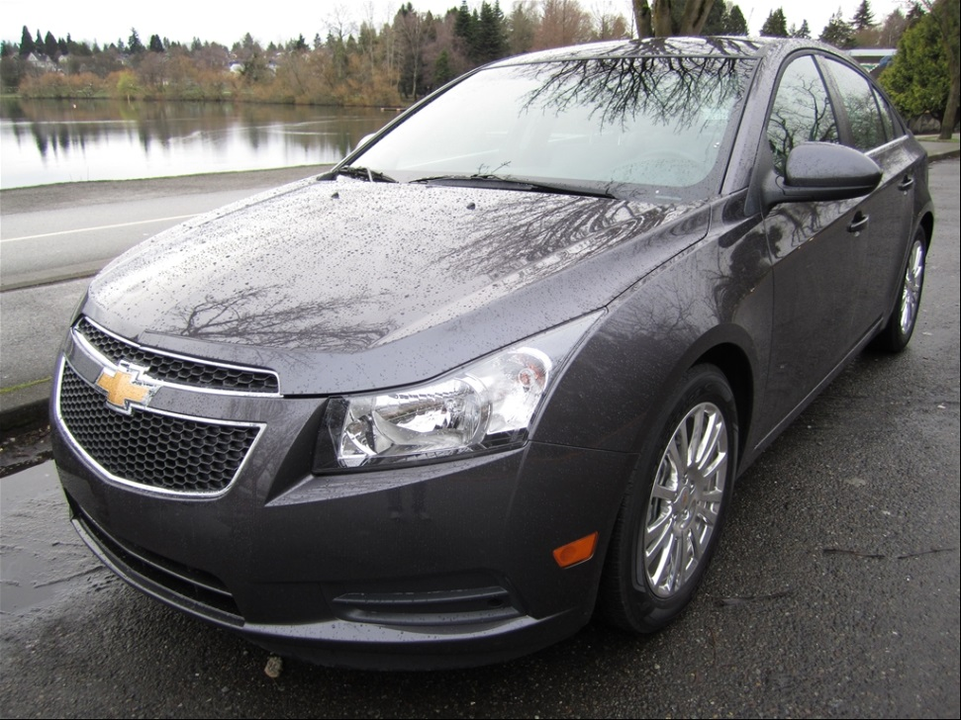
Wise Buy: car
2011 Chevrolet Cruze
Price: $16,000
Why is it WISE?
This car is cheaper and it’s the same bran from the other.
I sacrifice the year because others are more new.

Slide 16
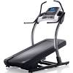
Conspicuous Buy: Running Machine
Nordic Track running machine
Price: $2,499
Why is it conspicuous?
Its expensive and it has more things that people like.
Why is it expensive?
This running machine its expensive because its made with good material.

Slide 17
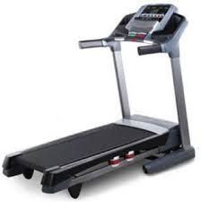
Wise Buy: Running Machine
Weslo Cadence running machine
Price: $287
Why is it WISE?
This machine is cheaper and has similar qualities from the others.
I sacrifice the brand of the machine but I don’t care that much.

Slide 18
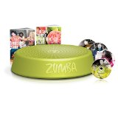
Conspicuous Buy: Zumba video
Zumba Fitness
Price: $59.95
Why is it conspicuous?
Its expensive and have a lot of resources to do different exercises.
Why is it expensive?
This video is expensive because it has good quality and also because most of the people want this resource.

Slide 19
Wise Buy: Zumba video
Various Artist Zumba fitness
Price: $5.99
Why is it WISE?
This video is cheaper and has similar from the other.
I sacrifice the minutes from the other because this videos just last for a few minutes and also the resources that the other have.

Slide 20
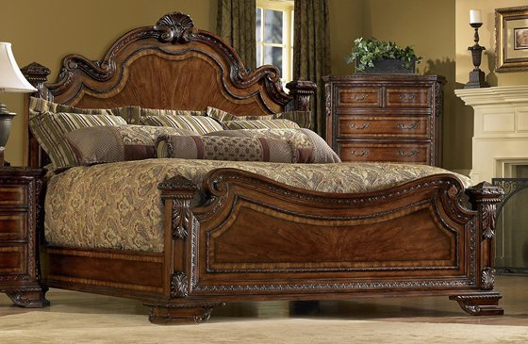
Conspicuous Buy: King bed
Old World king bed
Price: $999.99
Why is it conspicuous?
Its expensive and its confortable and has a good looking.
Why is it expensive?
This king bed is made of a good material and its brand.

Slide 21
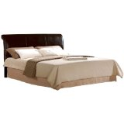
Wise Buy: king bed
Crown Mark
Price: $186.49
Why is it WISE?
This bed is cheaper and has a good looking even though is no the same as the other.
I sacrifice the brand of the bed but I don’t care that much.

